Slide 1
Agent Tools and MCPs
Prepared by: Muhammad Abdul Qayum
National Textile University, Faisalabad
Ref: Building Agents with OpenAI Agents SDK

Slide 2
what you will learn as part of this chapter:
Create custom tools by defining Python functions and registering them with @function_tool.
Use Pydantic models to validate tool inputs and define clear schemas for agents.
Control when and how tools are used through settings like tool_choice and tool_use_behavior.
Extend agent capabilities using built-in OpenAI tools such as Web Search, File Search, and Code Interpreter.
Treat entire agents as tools to enable modular, multi-agent workflows.
Connect to external MCP servers to retrieve tools without building them manually.

Slide 3
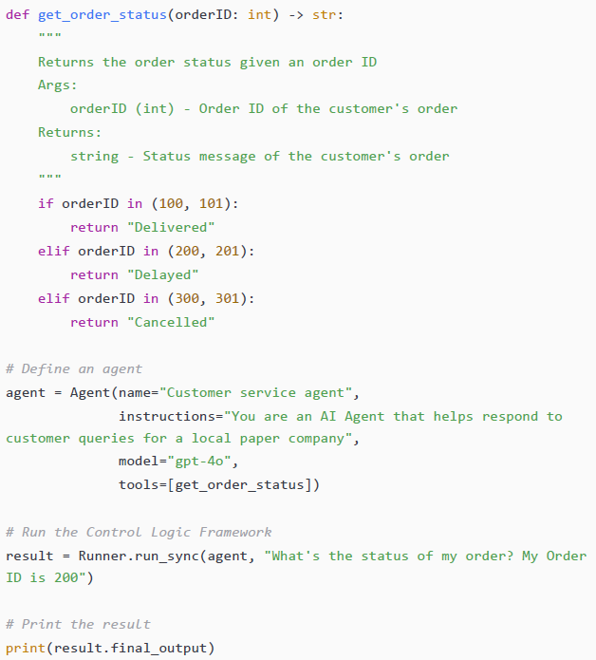
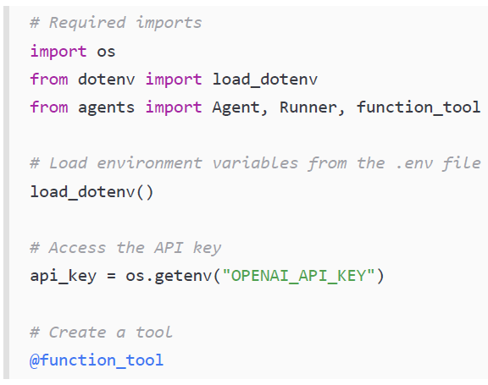
Defining a new tool
@function_tool decorator
In this case, we did not have to manually write a JSON schema; the SDK generated it from the function signature.

Slide 4
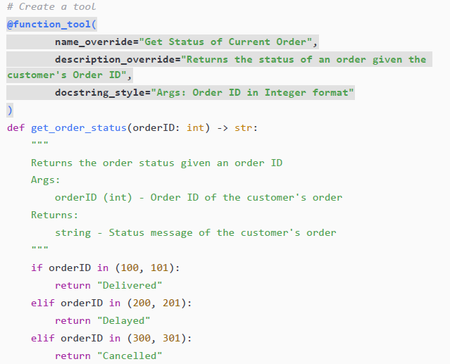
Overriding the default characteristics of the function.
name_override
description_override
docstring_style

Slide 5
When Overriding the default characteristics of the function required.
Gives developers more control over how tools are presented to the agent.
name_override allows a clearer, more descriptive tool name than the original function name.
Useful when function names are too generic or unclear.
Helps the agent understand purpose accurately instead of guessing — because even AI shouldn’t play charades .
Supports localization needs, formatting rules, or domain-specific naming.
Helps distinguish tools that have similar structures but different behaviors.

Slide 6
Agent and tool behavior
The Runner sends the current conversation history to the LLM.
The LLM returns either:
a final response, or
a request to call a tool.
If a tool call is requested:
The Runner executes the relevant Python function,
Adds its output back to the message history,
Repeats the cycle until a final answer is produced.
By default, the model decides when to use tools — but developers can influence this behavior through SDK configuration settings.

Slide 7
ModelSettings Controlling Tool Usage
This setting determines how much freedom the model has in choosing tools:
auto (default): The model decides if and which tool to call — like giving it the steering wheel.
required: Forces the model to use a tool — imagine saying “No excuses, you must use one!”
none: Blocks tool usage completely — like locking the toolbox.

Slide 8
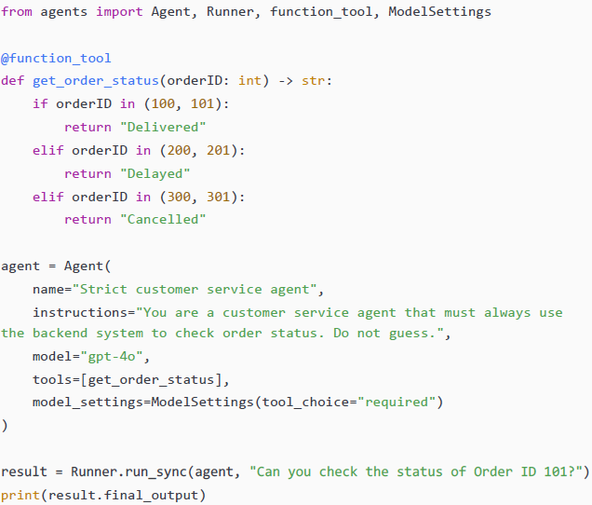
Example

Slide 9
Tool use behavior (run_llm_again (default)
. run_llm_again (default)
After a tool gives its output, the agent feeds that result back to the LLM so the LLM can:
✔ interpret it ✔ format it ✔ continue reasoning ✔ decide whether more tool calls are needed
This is useful when tool results need explanation — like "The database says 42 — why is that meaningful?"
Think of it as “tool output + LLM brain = polished answer.”

Slide 10
Tool use behavior (stop_on_first_tool)
After the first tool output, the agent stops immediately and treats that output as the final answer.
Useful when tool output already is the answer, like:
A database query
A calculation
A lookup response
No need to ask the LLM again — it’s like eating fries straight from the box instead of sending them back to the kitchen to be dressed up.

Slide 11
Tool use behavior ( stop_at_tool_names)
This option gives fine-grained control:
You list tool names where you want the agent to stop after their execution — but allow normal looping for other tools.
✔ Some tools return raw answers ✔ Others require interpretation
This mode lets you mix controlled behavior with flexibility.
Notes:
It’s like telling your kids:“If you bring me water, I’ll drink it immediately.”“But if you bring me homework, I’ll check it first.” 😄

Slide 12
Tool use behavior Why does this matter?
It lets you design agents that are:
Deterministic (always predictable)
Flexible (reasoning after tool output)
Optimized for performance (skip extra LLM calls when unnecessary)

Slide 13
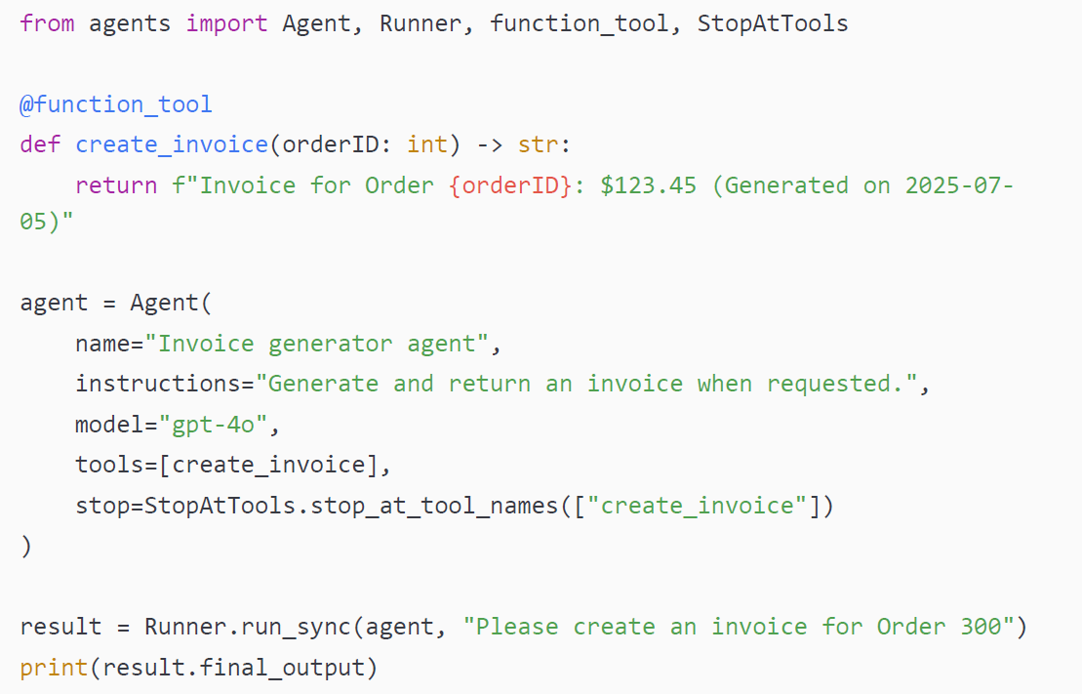
Example
In this example, the agent calls the create_invoice tool and returns the raw output string directly, without any additional LLM processing. This preserves the original content from the tool output.

Slide 14
Complex tool inputs with Pydantic
Why Pydantic for Tools?
Tools often require complex structured input
Simple types (str, int) are not enough
Pydantic provides validation + structure
Makes agent-tool communication safe and predictable
2 — Key Benefit of Pydantic Models
Define input as a BaseModel object
Treats entire model as one parameter
SDK automatically builds nested JSON schema
LLM easily understands required structure
3 — Real Use Case: Processing Refunds
Refunds need many fields:
Order ID
Customer email
Reason
Amount etc.
Multiple refunds may need handling in one request
— Why This Matters
Without models → messy, error-prone arguments
With Pydantic → structured, validated, clear input
Makes complex workflows scalable and reliable

Slide 15
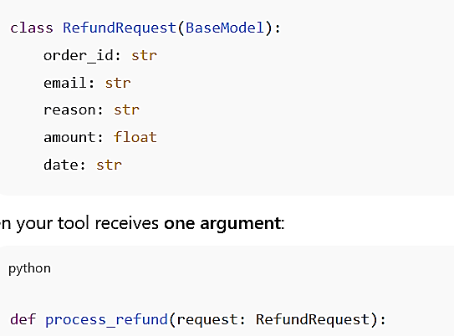
Why Pydantic matters in agent tools
OR

Slide 16
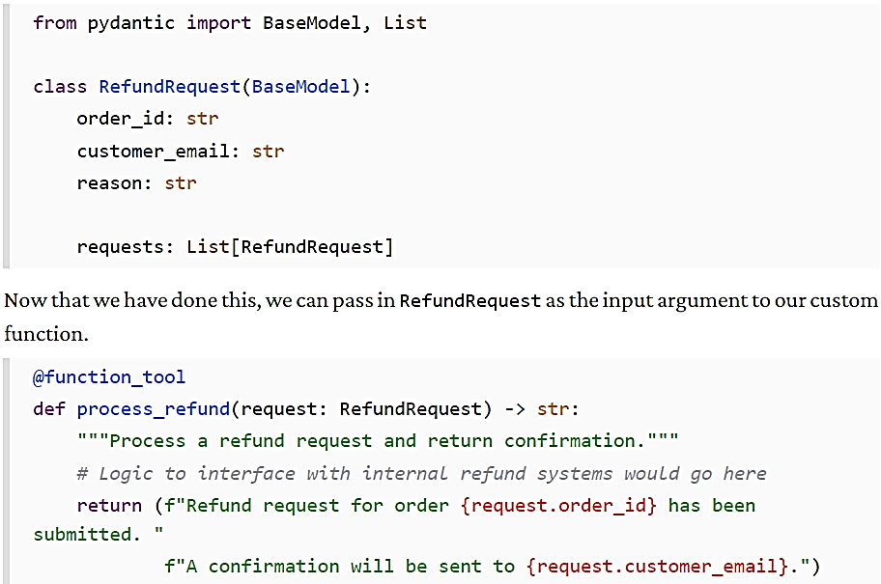
Example

Slide 17
Validation Safety
If the model passes malformed or hallucinated data → SDK raises an error instead of silently failing
Lets developers catch and handle errors
Improves application robustness
Critical because LLM tool calls are not deterministic

Slide 18
Examples of custom tools

Slide 19
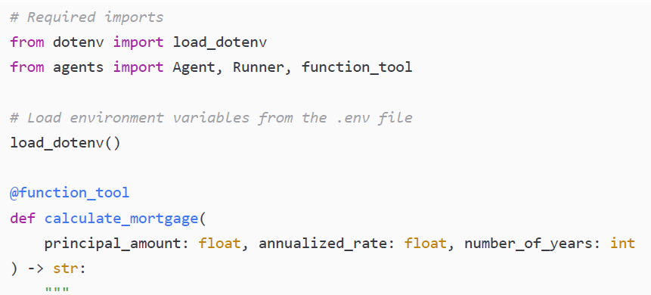
Arithmetic computation tool(mortgage example 1/3)
Notes:
# Required imports
from dotenv import load_dotenv
from agents import Agent, Runner, function_tool
# Load environment variables from the .env file
load_dotenv()
@function_tool
def calculate_mortgage(
principal_amount: float, annualized_rate: float, number_of_years: int
) -> str:
"""

Slide 20
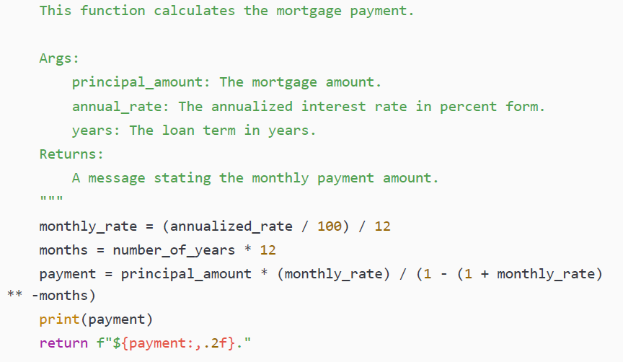
Mortgage Example ( 2/3)

Slide 21
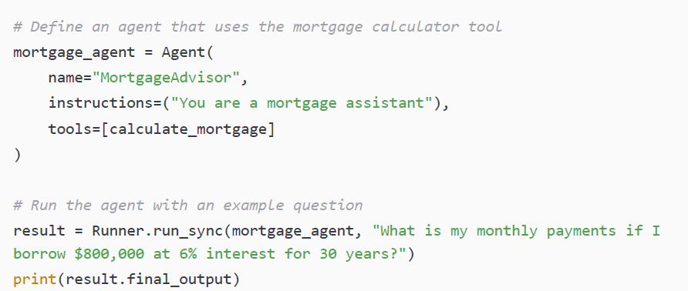
Mortgage Example ( 3/3)

Slide 22
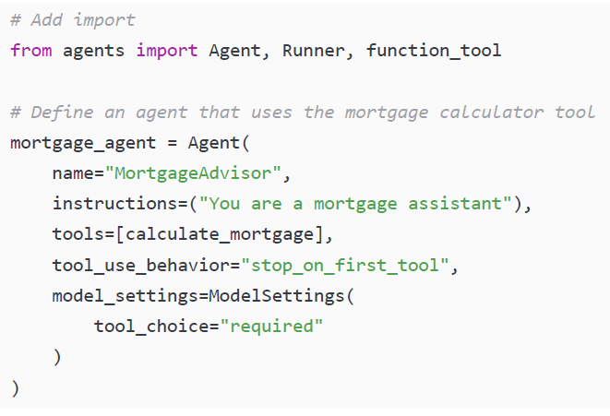
Code to force the agent to call the tool and to return the output from the tool instead of calling the LLM again
Notes:
We may want to do this to guarantee deterministic and auditable responses, especially in scenarios where accuracy is critical, such as a mortgage application. It also improves performance by reducing the number of LLM calls in the loop.

Slide 23
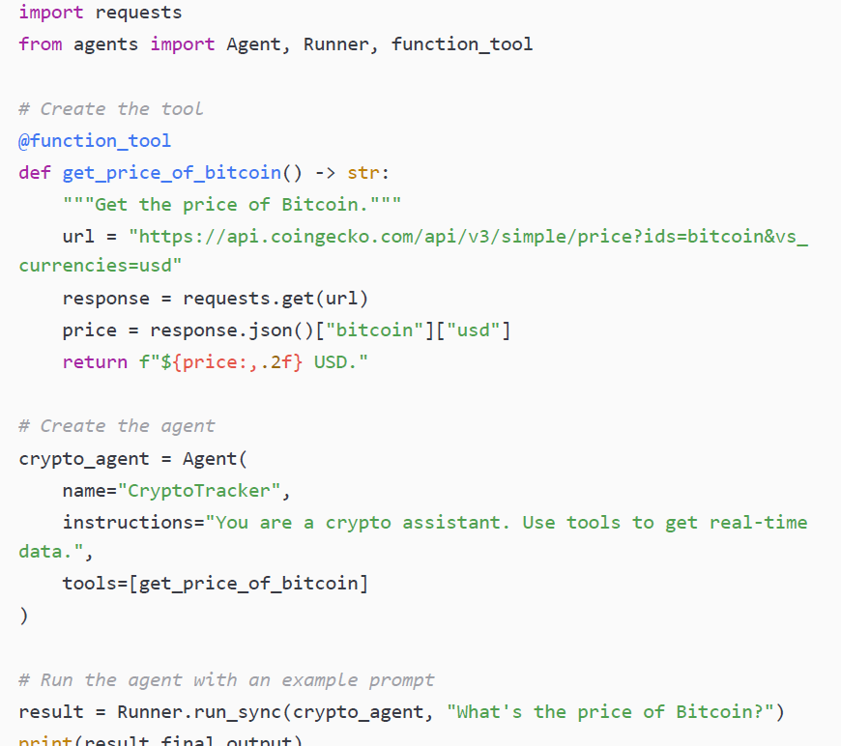
External API call tool
Notes:
The next custom tool we will make uses an external API call. APIs are connectors to different programs and resources. The Gmail API enables you to read your emails, send an email, and view calendar invites. The Airbnb API enables you to find Airbnb listings, make a listing, or send a message. APIs are also used to access real-time data, such as customer records, weather information, or cryptocurrency prices.
In this example, we will create a tool that will fetch the current price of Bitcoin in USD. Create a new Python script called crypto_pricing_agent.py, with the following code:

Slide 24
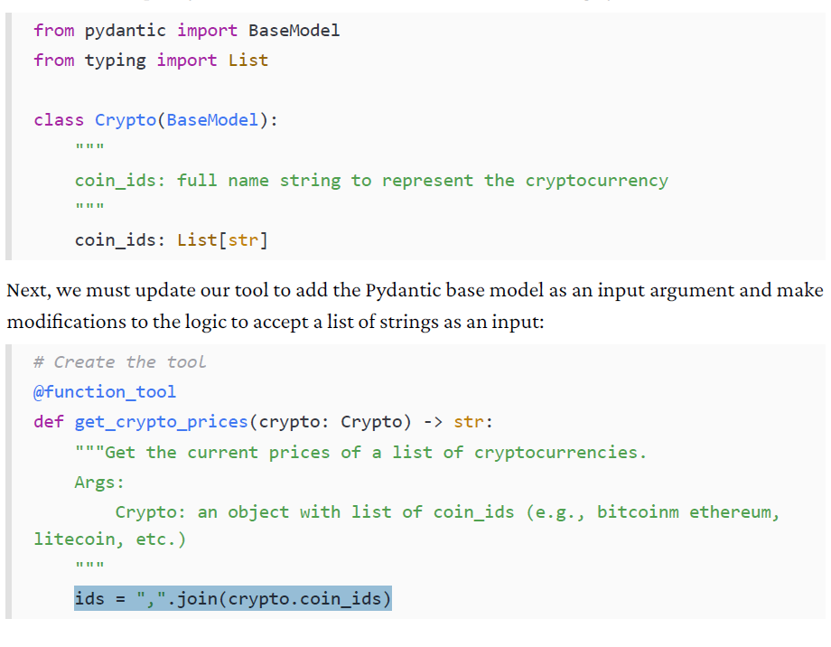
Multiple coin query
Notes:
crypto.coin_ids
This is most likely a list of coin IDs, e.g.:
["btc", "eth", "doge"]
2. .join(...)
.join() is a string method in Python.
It combines list items into one string, placing what’s inside the quotes between each item.
3. ",".join(...)
This says: combine the list elements with a comma between them.
So if crypto.coin_ids = ["btc", "eth", "doge"]
Then:
ids = ",".join(crypto.coin_ids)
produces:
ids = "btc,eth,doge"

Slide 25
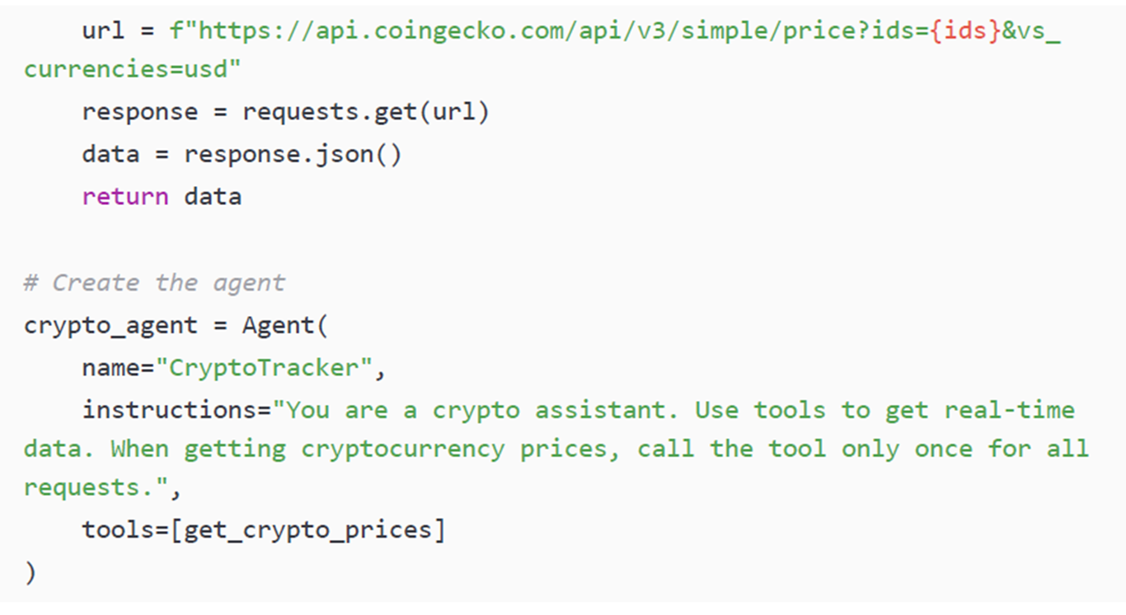

Slide 26
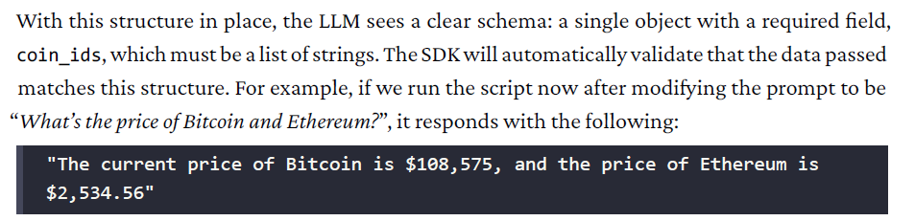

Slide 27
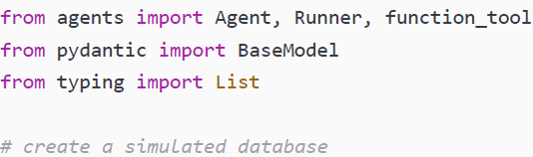
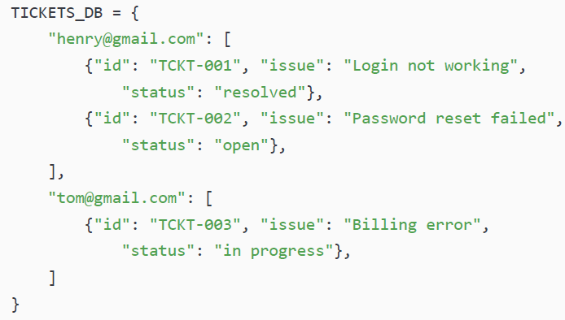
Database query tool (database_query.py )

Slide 28
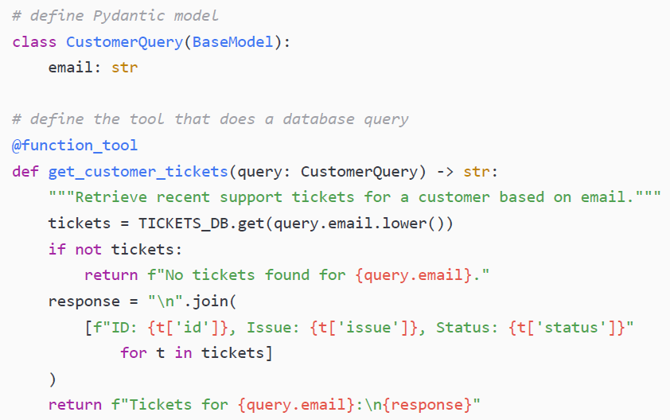
Database query tool

Slide 29
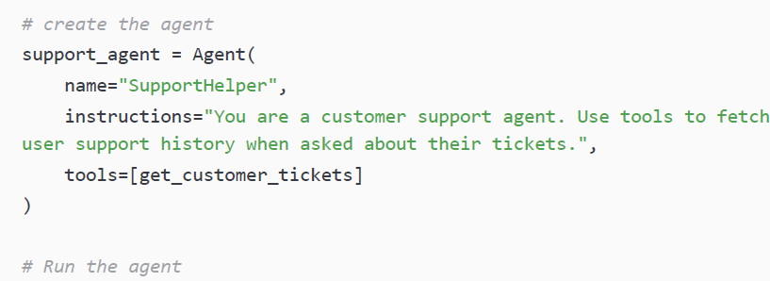
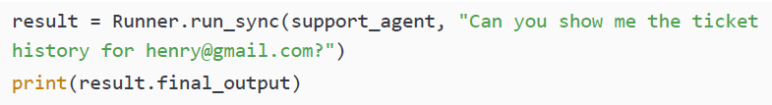
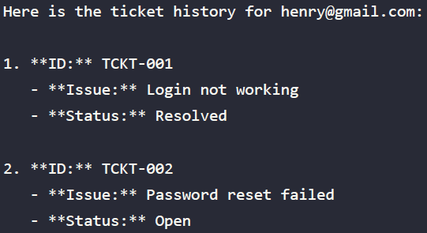
Database query tool

Slide 30
Chained tool calls
Smart Tool Orchestration by the LLM
The LLM can decide whether and when to use tools
It can also choose the execution order of multiple tools
Supports multi-step workflows, where:
Output of one tool becomes input to another
The agent can reuse the same tool multiple times if needed
For example, following our customer service theme, we have a tool called get_customer_orders (which retrieves all orders for a specific customer ID) and another tool called get_order_information (which retrieves the status of an order ID). Create a new Python script called tool_chaining.py,

Slide 31
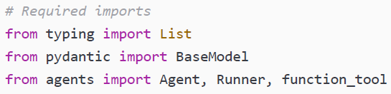
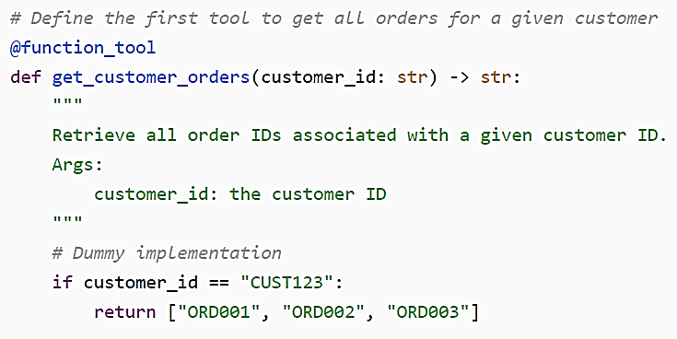

Slide 32
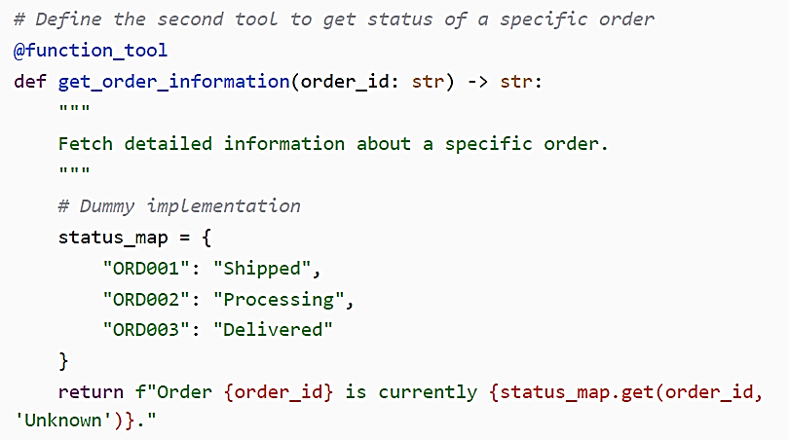

Slide 33
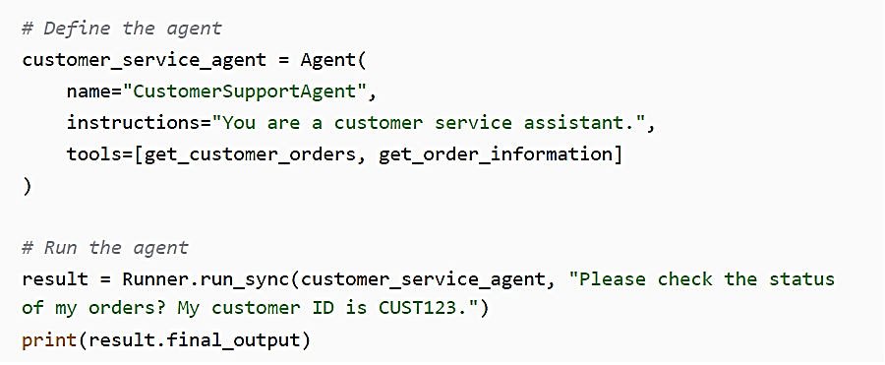

Slide 34
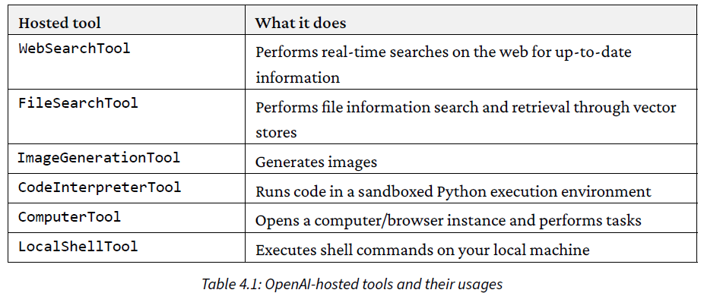
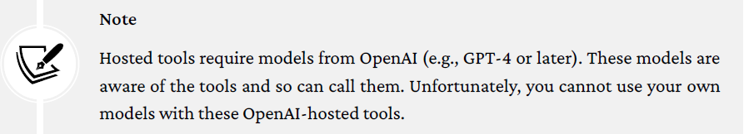
OpenAI hosted tools

Slide 35
Agents as tools

Slide 36
Agents as tools
Agent-as-Tool Architecture
Agents SDK allows using one agent as a tool for another agent
This creates a hierarchical multi-agent architecture
Orchestrator vs Worker Agents
Orchestrator Agent
Controls workflow and decision-making
Delegates tasks to other agents
Worker Agents
Act as modular units with:
Their own system prompts
Individual reasoning process
Their own tools or capabilities
From the orchestrator’s view, they are invoked just like any tool

Slide 37
Handoff versus agent-as-tool patterns
Agent-as-Tool Pattern
One agent calls another agent like a tool
The first agent remains in control of the workflow
The called agent only performs a specific subtask
Handoff Pattern
One agent fully transfers control to another agent
The second agent takes over the entire interaction or task
It remains in charge until:
The task is completed or
It chooses to hand control back
Key Difference Slide
Agent-as-Tool:
Controlled invocation
Caller stays in charge
Handoff:
Full delegation
Control moves to another agent

Slide 38
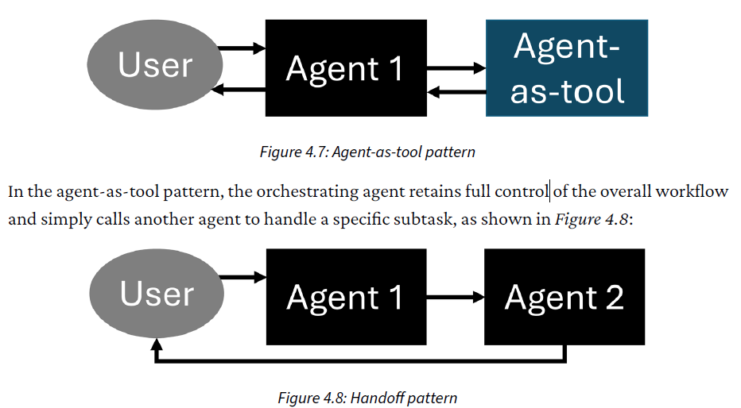

Slide 39
Calling customer service illustrates the two patterns:
Handoff pattern:
Manager transfers you to another department
The new agent continues the entire conversation
Agent-as-Tool pattern:
Manager puts you on hold
Gathers info from coworkers
Returns to continue the conversation
Slide — Workflow Support in the SDK
Both handoff and agent-as-tool patterns are fully supported
They can be combined for advanced workflows
Slide — Key Trade-Off: Control
Handoff:
More autonomous, modular workflow
Control moves to another agent
Agent-as-Tool:
More centralized coordination
Original agent keeps control

Slide 40
When to Use the Handoff Pattern
Fits naturally into another agent’s domain
Worker agent should handle the entire user interaction for that segment
Intermediate steps do not require tight oversight
Notes:
Meaning of “Intermediate steps do not require tight oversight”
It means:
You don’t need to monitor or control every small step the agent takes while completing the task.
You trust the agent to handle the internal reasoning and actions on its own.
You don’t need updates after each step (no partial outputs, no back-and-forth checking).
You only care about the final result, not how the agent gets there.
Easy example
If you hand off a customer to the Billing Department agent:
You don’t need to watch how many checks they run.
You don’t need to supervise their decisions step-by-step.
You only want the final outcome (e.g., “Refund processed successfully”).
So "no tight oversight" means you let the agent work independently without micromanaging.

Slide 41
when to use the agent-as-tool pattern,
You need to stay in control of the overall logic or conversation (The main/orchestrator agent should supervise and guide the process.)
You must combine information from multiple worker agents (Each worker does a small part, and the orchestrator puts everything together into one final answer.)
You require full visibility of all intermediate steps (The orchestrator needs to see every tool call, every response, and every action for correctness, compliance, or debugging.)

Slide 42
Turning an Agent into a Tool (as_tool())
Any agent can be converted into a tool using the as_tool() function.
as_tool() returns a FunctionTool object, which can be added to another agent’s tools list.
You must provide a name and description, just like when defining custom function tools.
The orchestrator agent relies on the name and description to decide when and why to call this agent-tool.
Therefore, clear, descriptive naming and documentation are critical for correct tool selection.

Slide 43
agents_as_tool.py
LocationAgent, whose sole purpose is to retrieve latitude and longitude values for a given city, using WebSearchTool
DistanceCalculatorAgent,
Notes:
LocationAgent, whose sole purpose is to retrieve latitude and longitude values for a given city, using WebSearchTool
•
DistanceCalculatorAgent, which is equipped with CodeInterpreterTool, allowing it to write and execute Python code to compute distances between two coordinate pairs
The important part comes when we call .as_tool() on each of these agents. This wraps each agent as a callable tool, assigning it a tool_name argument and tool_description argument so that the orchestrator agent can reason about when and how to call it. These names and descriptions play a key role in the LLM’s ability to select the right worker agent for a given task, so they should be specific and informative.
Finally, we create an orchestrator agent. Its instructions guide it to use the worker agent (now wrapped as tools) to complete a larger goal: calculating the distance between two cities. When we run this agent with the input query, What’s the straight-line distance between Toronto and Vancouver?, the system chains the tool calls behind the scenes. First, LocationAgent is invoked twice to fetch coordinates for each city. Then, DistanceCalculatorAgent processes those coordinates to compute the final result.
This final_output object contains the correct answer:

Slide 44
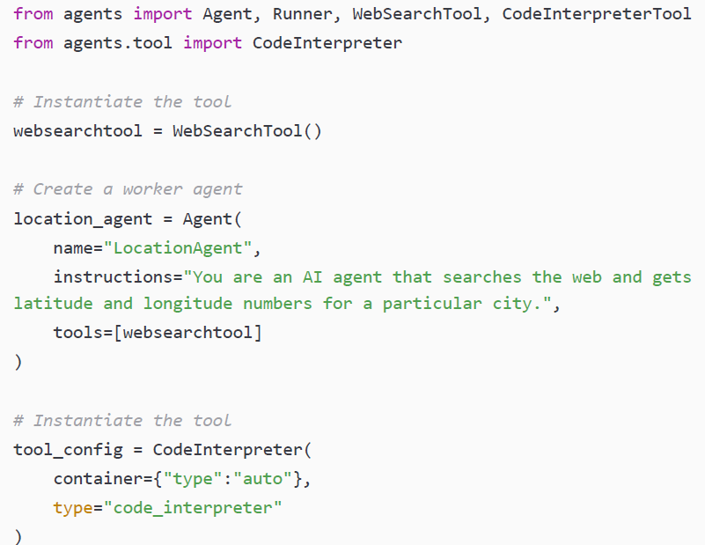

Slide 45
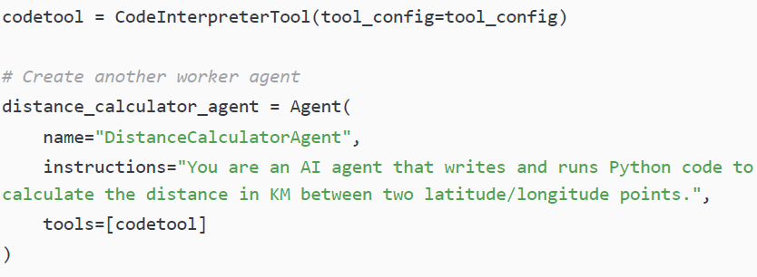
built-in capability that lets the model execute Python code in a secure sandbox during a conversation
built-in capability that lets the model execute Python code in a secure sandbox during a conversation

Slide 46
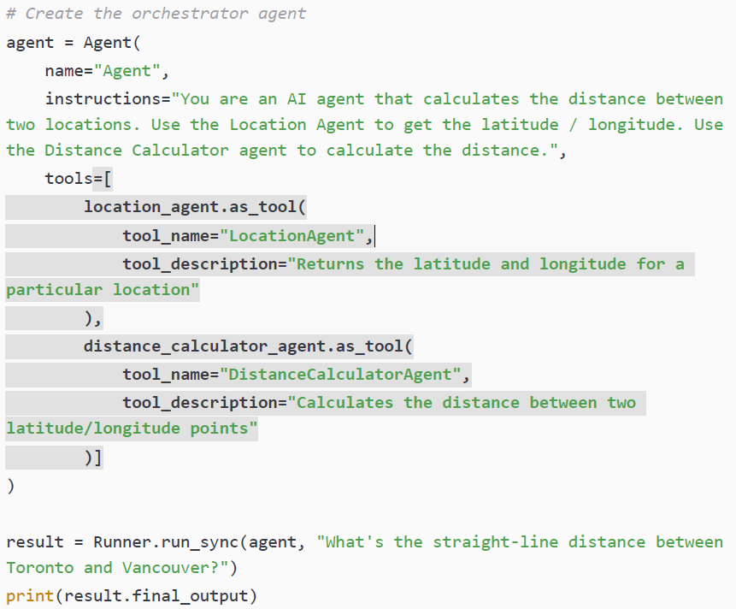
Page 94

Slide 47
Model Context Protocol

Slide 48
Why MCP Was Created
Agentic AI is rapidly growing, but each framework originally connected tools to agents differently.
This lack of standardization made it hard to reuse or share tools across platforms like Agents SDK, LangGraph, and CrewAI.
Developers often had to rebuild the same tool multiple times for different ecosystems.
High-quality tools built in one framework were not easily portable to another.
The industry needed a universal protocol for tool–agent communication.
MCP (Model Context Protocol) was created to provide this cross-framework standard, enabling interoperability and tool reusability.

Slide 49
What MCP Is and Why It Matters
MCP is a standardized protocol that defines how AI agents discover and call tools—whether local or remote.
It works like a universal adapter (USB-C for agents), allowing any MCP-compatible tool to connect to any MCP-compatible agent.
Tool developers can build an MCP server once, and it becomes compatible with multiple AI frameworks (OpenAI Agents SDK, Anthropic, etc.).
MCP ensures interoperability across models and ecosystems without rewriting or re-integrating tools.
The result is a plug-and-play tool ecosystem, enabling faster development, reuse, and sharing of tools.

Slide 50
Adding an MCP server as a tool
The Agents SDK provides built-in support for consuming tools from an MCP server.
developers simply create a connection to the MCP server (local or remote).
This connection is then passed to the agent as a tool—just like any other tool object.
The SDK automatically manages the MCP connection, including tool discovery and communication.
All tools exposed by the MCP server become instantly available to the agent, without extra configuration.
This allows agents to seamlessly use external, third-party, or shared tools with minimal setup.

Slide 51
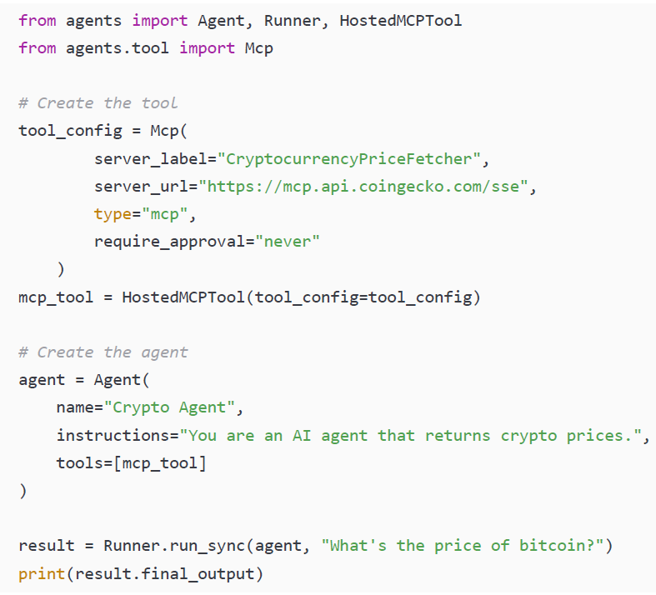
mcp_tool.py
Notes:
The URL https://mcp.api.coingecko.com/sse is the Server-Sent Events (SSE) endpoint for the public, keyless CoinGecko MCP Server, which is currently in public beta.
This endpoint is designed for first-time users, quick tests, and basic queries, allowing instant connection without registration.
It is compatible with most MCP-compatible clients and is recommended for maximum compatibility in configuration examples.
The server provides access to real-time market data, onchain analytics, market trends, rich metadata, historical performance, and crypto categories for over 15,000 coins across 1,000+ exchanges.
However, it is subject to shared rate limits and is not intended for heavy or production use.
For higher rate limits and access to more tools, users are advised to use their CoinGecko API key with the authenticated server at https://mcp.pro-api.coingecko.com/sse

Slide 52
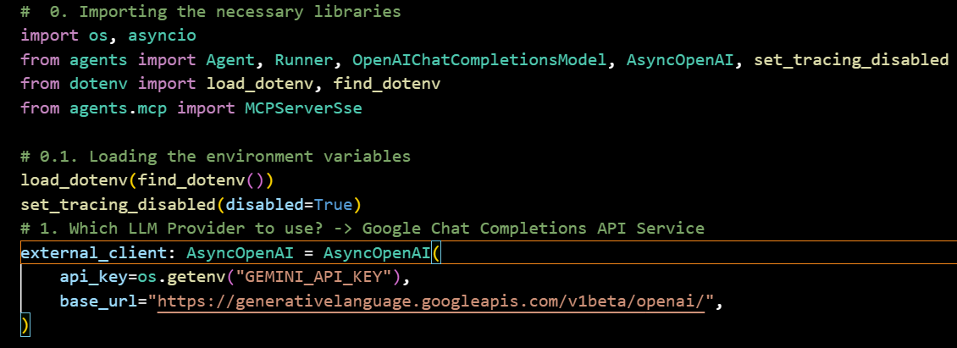

Slide 53
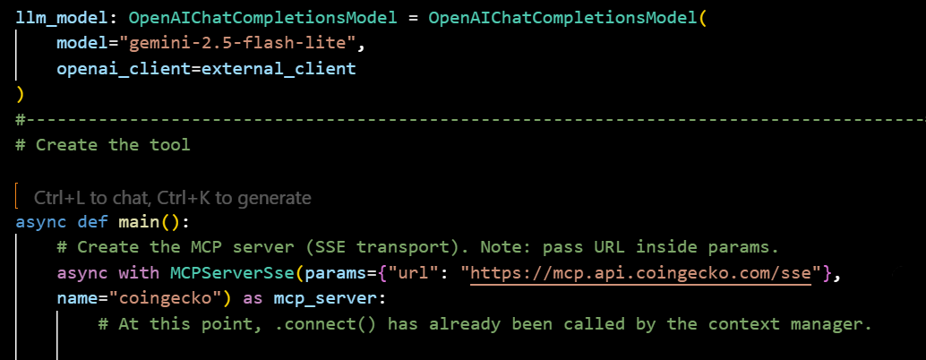

Slide 54
